Slide 1
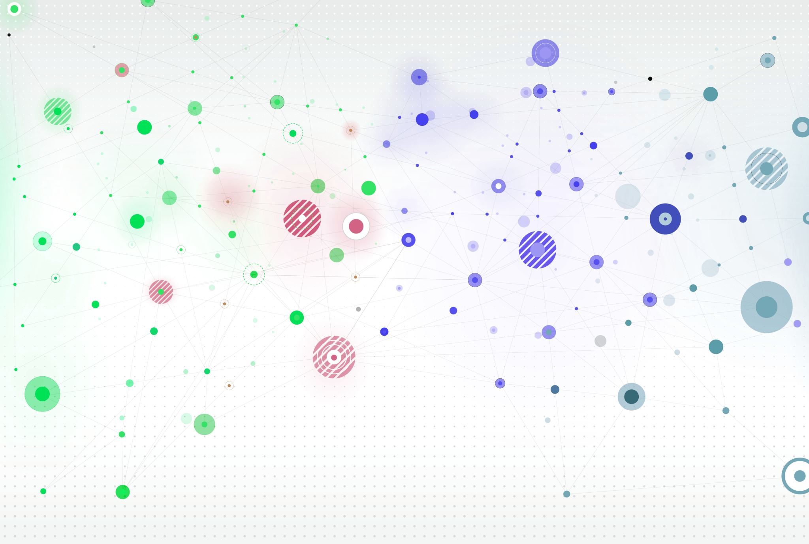


PAL Python Crashcourse

Slide 2
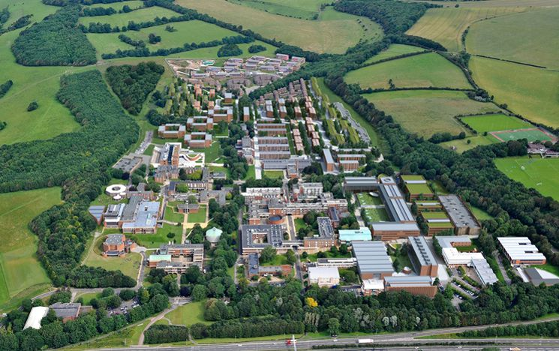
Contents
TReND
Peer Assisted Learning (PAL)
The course outline
Importance of data science
Python
What we will be covering
Walkthrough the worksheets
What to do when stuck

Slide 3
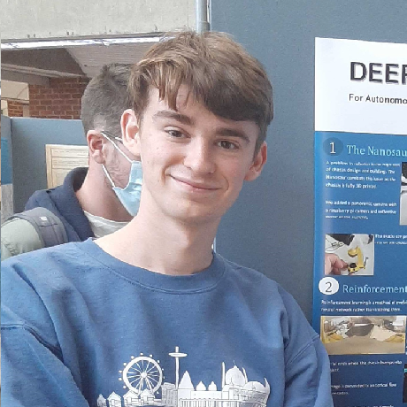

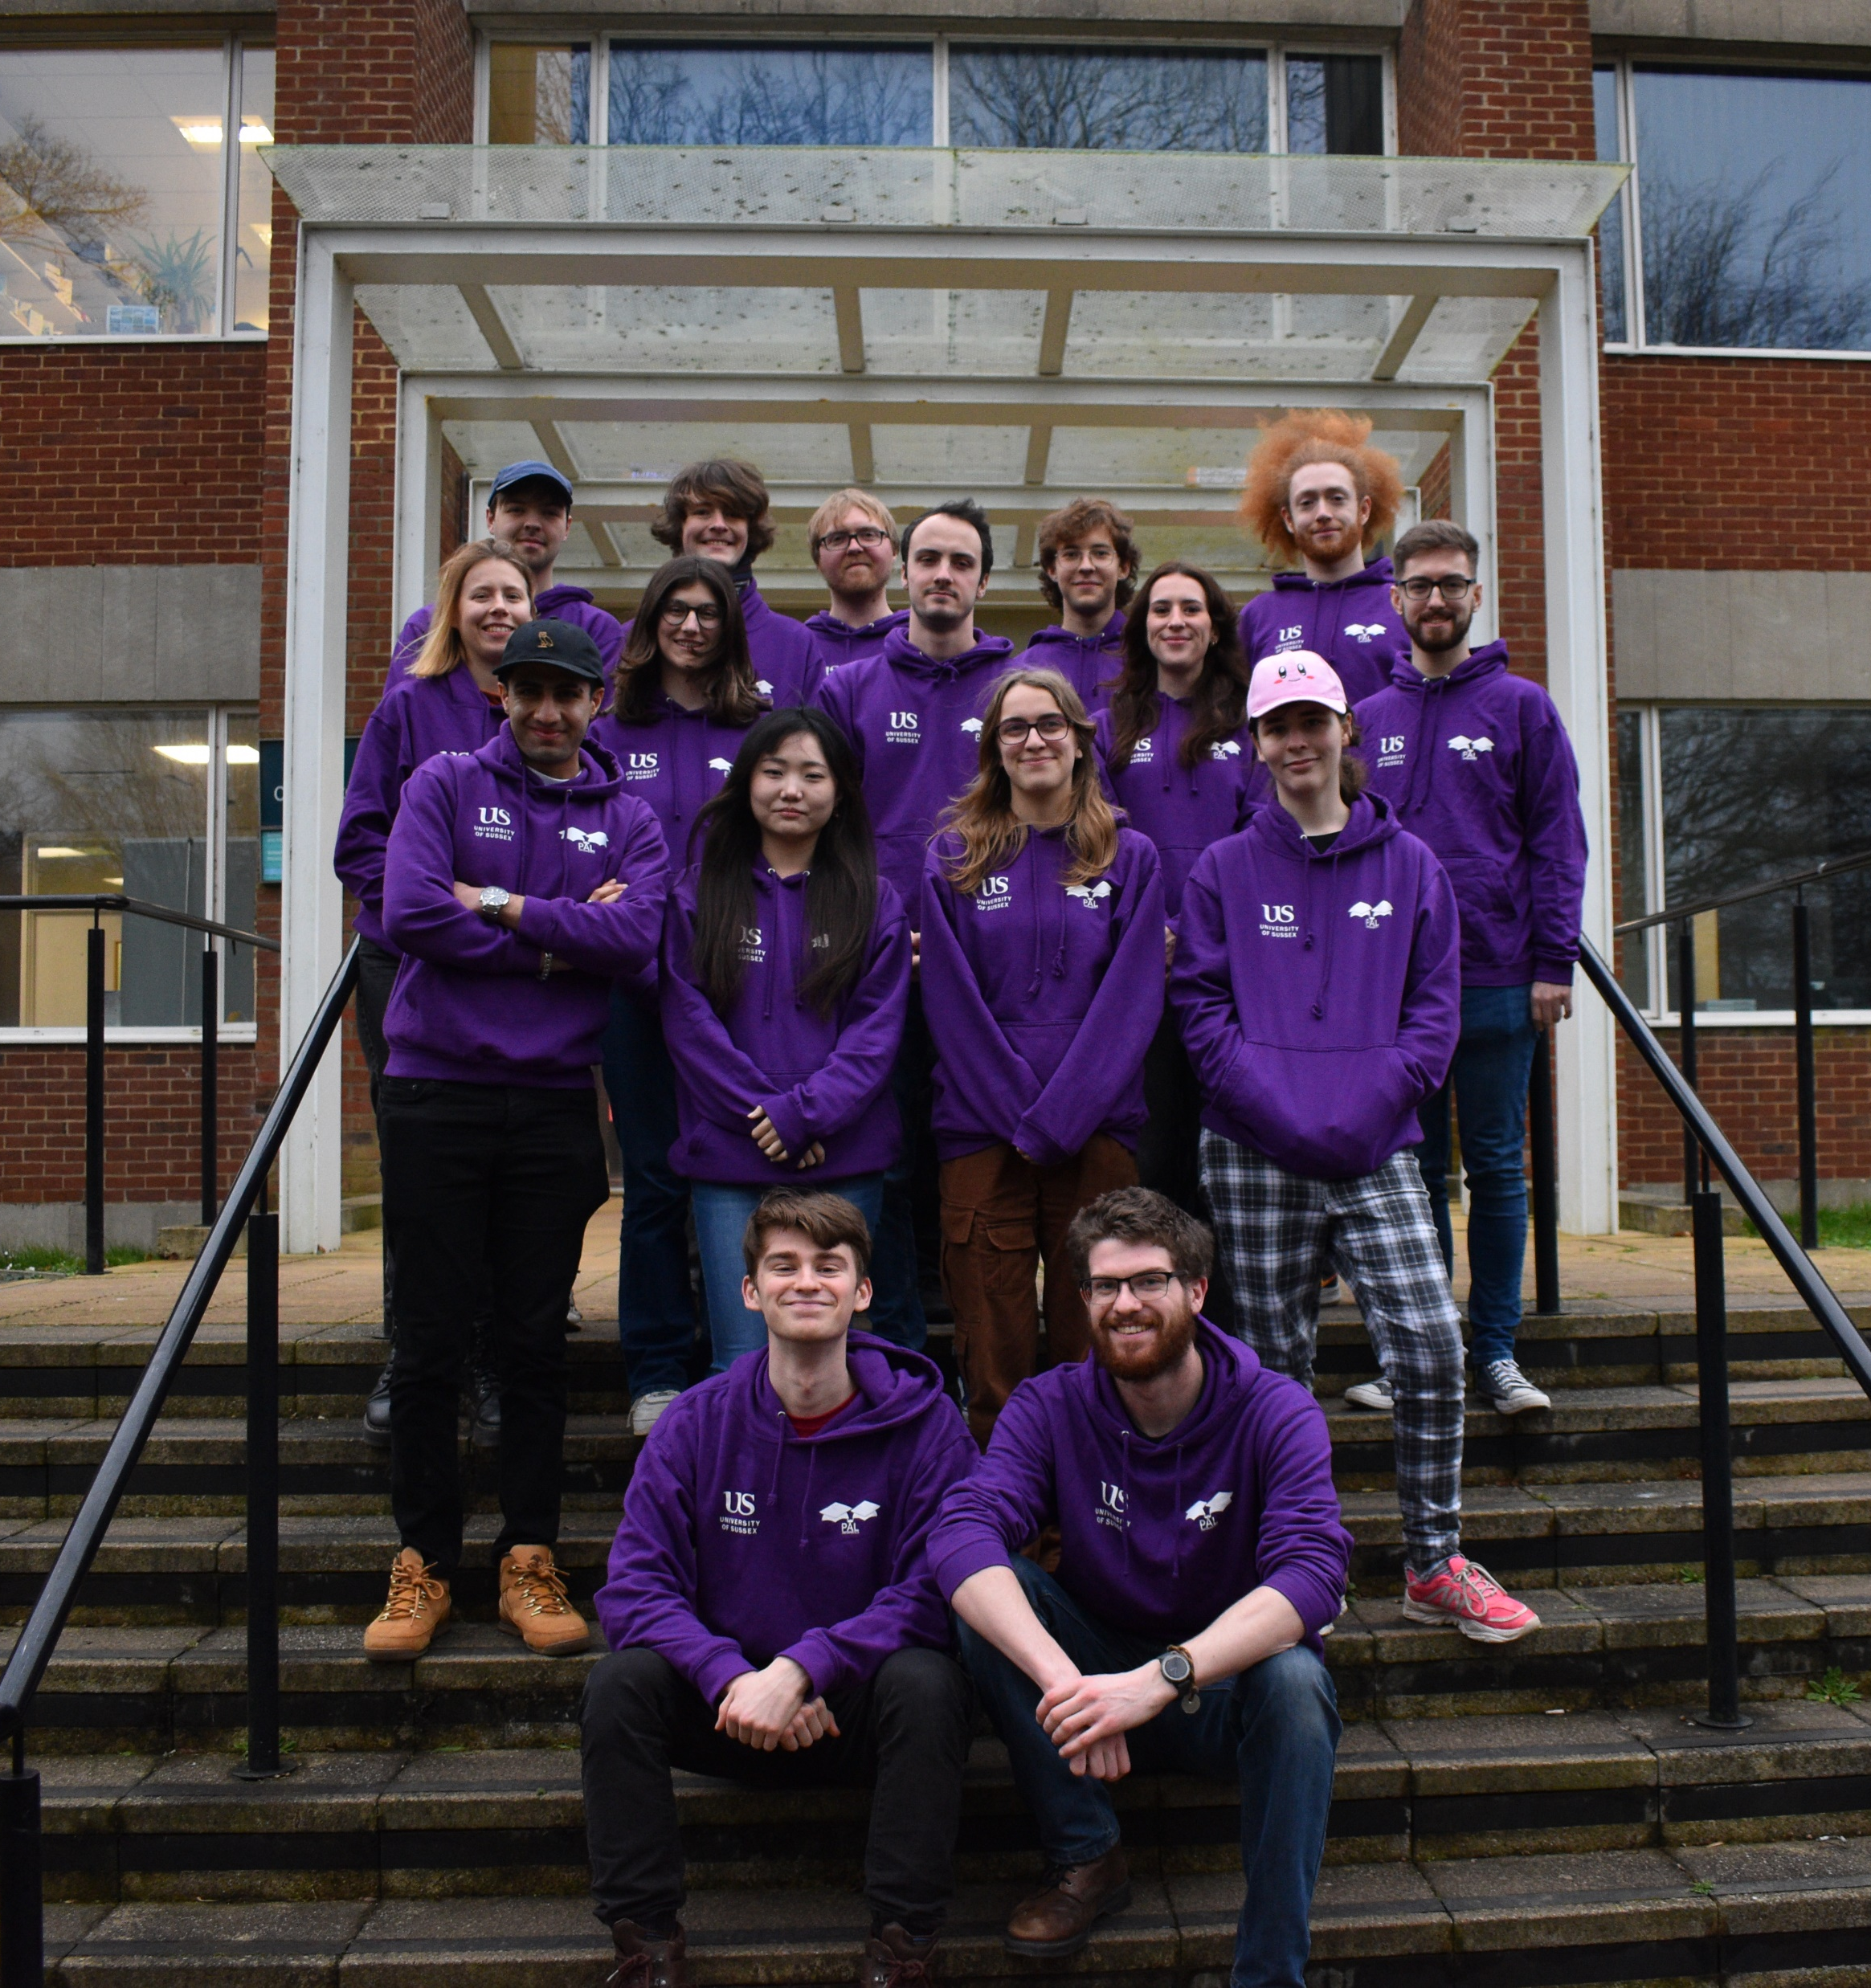

Introduction

Slide 4
TReND Teaching and Research in Natural sciences for Development in Africa
Promotes more access to scientific equipment and educational resources
TReND offers:
Open science development
Research training
Policy making
Equipment donation
Volunteering programs
As of 2023 over 10,000 people have engaged in TReND programs

Slide 5
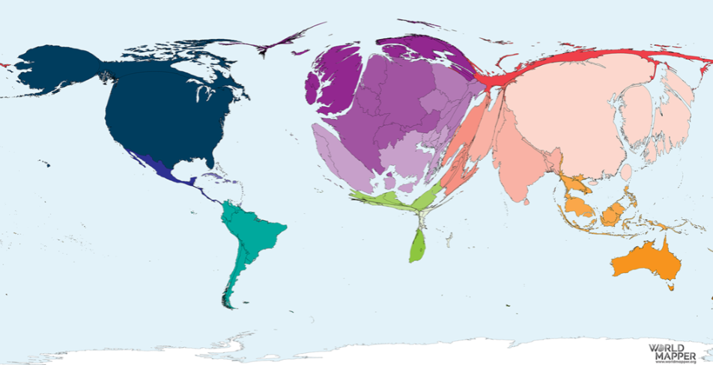
World reshaped based on publications
In order to tackle world problems, we need to collaborate with the whole world

Slide 6
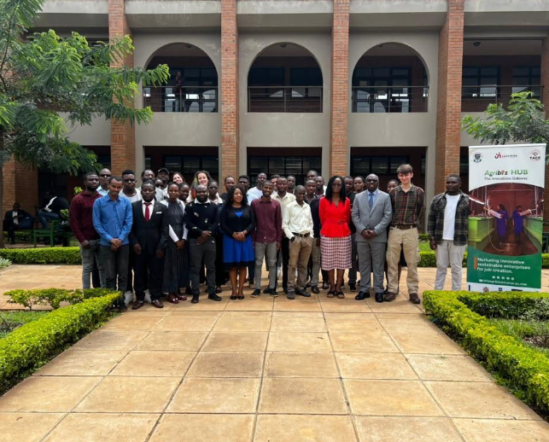
Where do we come in?
March 2023: we ran a ML/ data science course in Malawi, through TReND
Sending volunteers to Africa comes with costs, which makes projects less sustainable.
We developed an online course to lay better foundations to programming knowledge

Slide 7
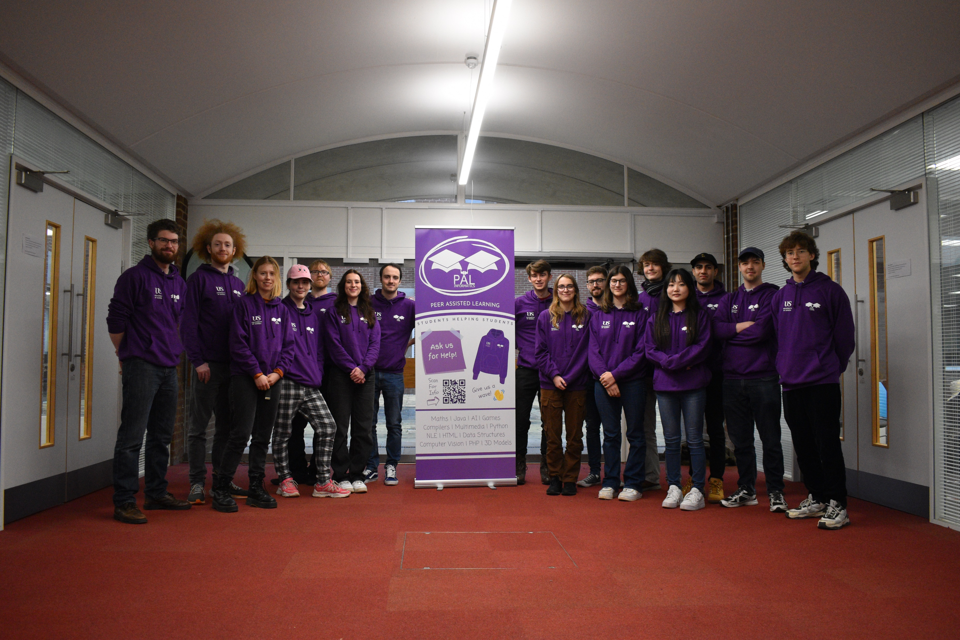
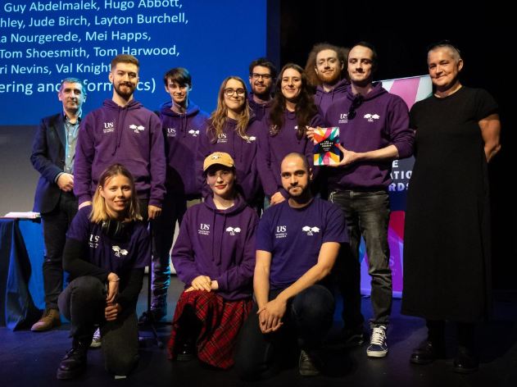
Peer Assisted Learning
Student mentor team, by students for students
Regarded as the most successful mentor scheme at Sussex
Student teaching is quite often “more fresh” than lecturers

Slide 8
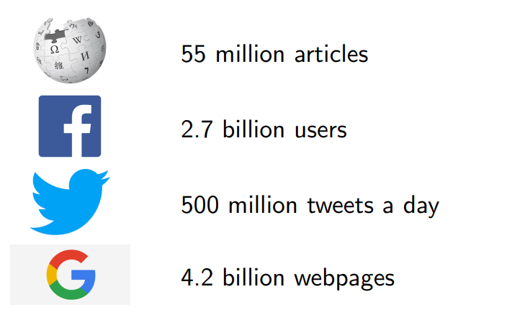
Why should you learn data science?
Everything is data!
You likely interact with machine learning on a daily basis
All science involves data collection and analysis, but the relationships between data and outcome is not always simple

Slide 9
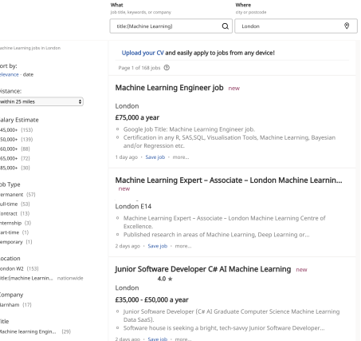
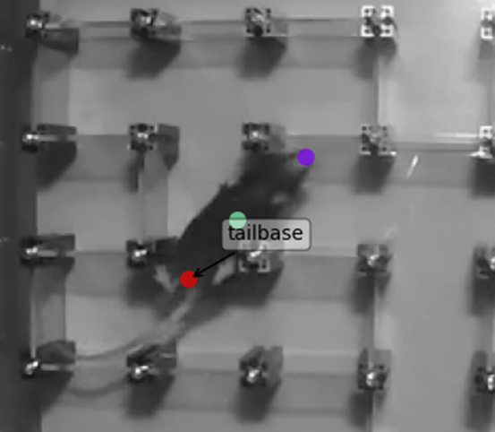
What is in it for you?
Maybe you are money oriented
Maybe you are science oriented
Machine learning can aid you in both
Oluwaseyi Jesusanmi,
Sussex PhD student

Slide 10

Why Python?
Python has many benefits
Arguably the easiest language
Huge amount of machine learning support
Most popular language (therefore more support)
You will find people will use languages that they were taught. People from a more statistical or life science background may use R
There is a lot you cannot do in R!

Slide 11

Course outline
Day One
Algorithmic thinking
Maths through programming
Data types
Day Two
statements/expressions/logic
Flow of control
Functions
Understanding Errors & The Call Stack
Day Three
Object Oriented Programming
Day Four
Scientific Python
Regression
Day Five
Neural Networks

Slide 12
Before you start
You will need to install VSCode

Slide 13
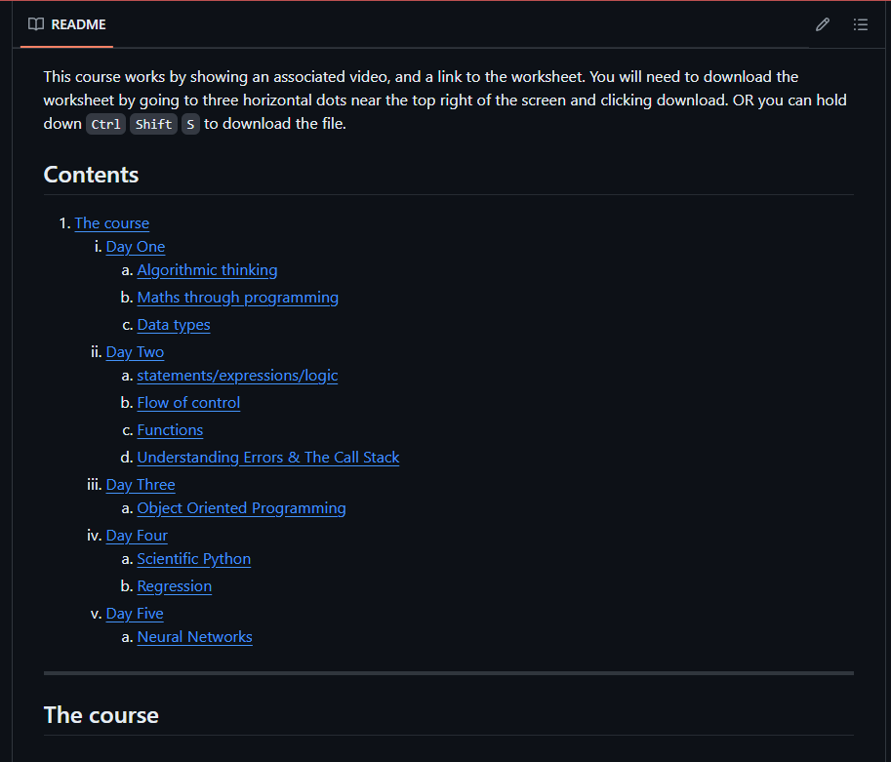
How it works
Each day you go to the GitHub page, on the main page scroll down to the table of contents. Select the day you are on

Slide 14

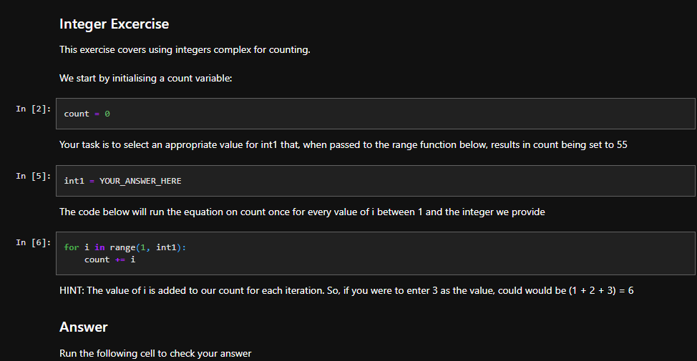
How it works
Watch the YouTube videos for each topic, and complete the worksheet

Slide 15
How it works
Attend the Q&A session via zoom at 4pm (Malawi time) each day where we will walk through lab sheets and answer questions of where you got stuck

Slide 16
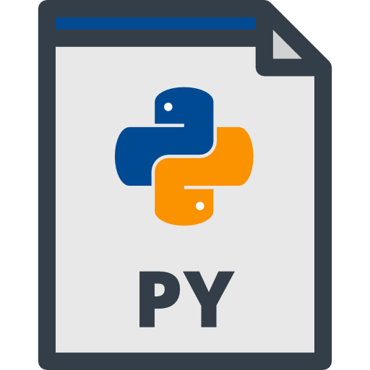
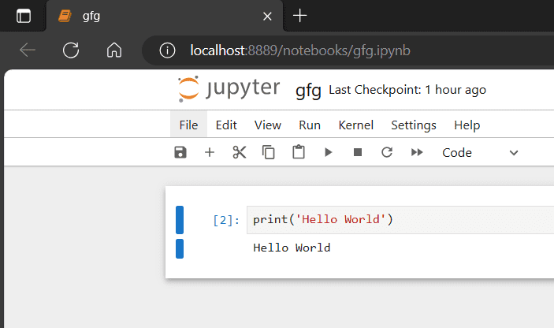
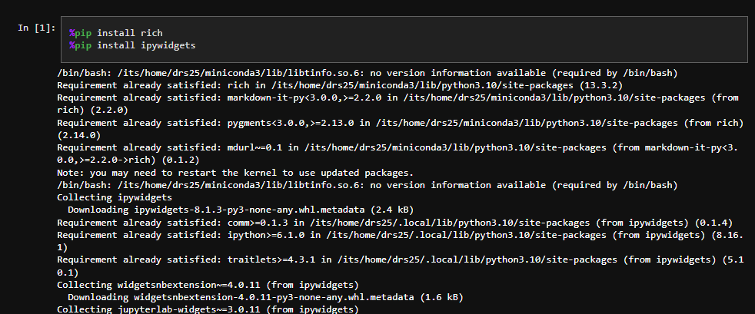
The worksheets
Python notebook format
At the start of each worksheet there are imports, some requires something called “pip”
Make sure to have an internet connection for the pip installs

Slide 17
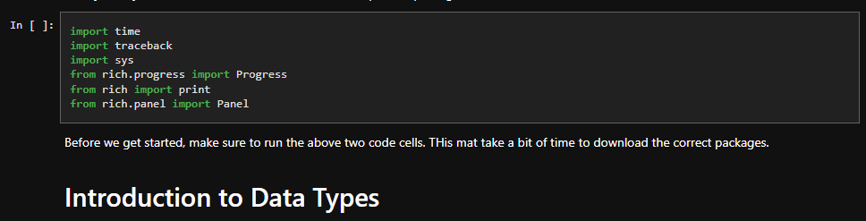
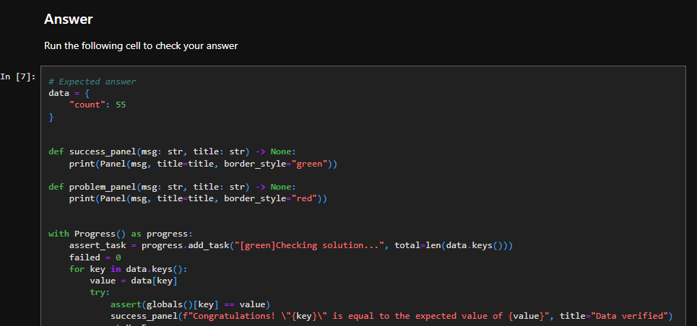
The worksheets
Once you have pip installed everything, scroll down.
There will usually be imports, run this code block to import needed libraries
From here, read through the sheet and complete the tasks
The code is auto marked!

Slide 18
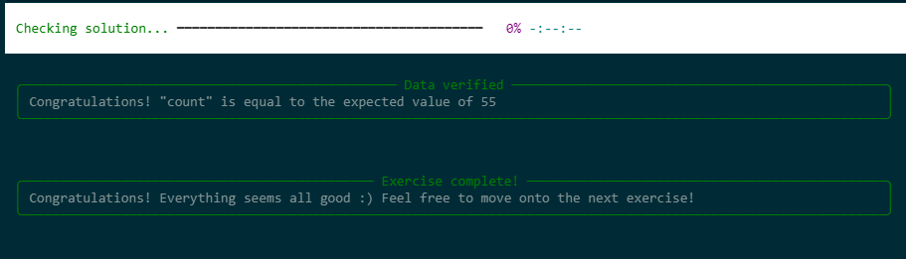
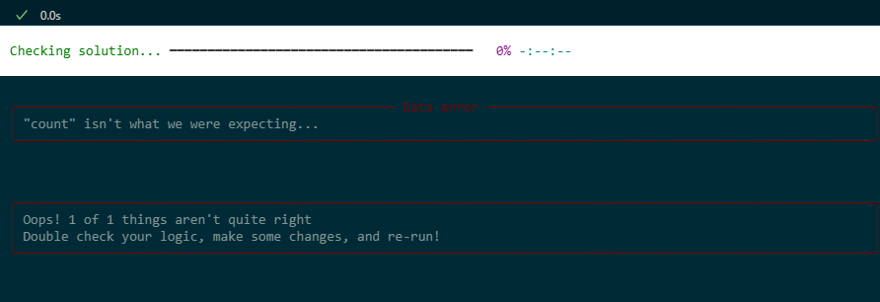
Auto marking
If you are correct, it will tell you, and you can move on
If you are not, it will also tell you.

Slide 19
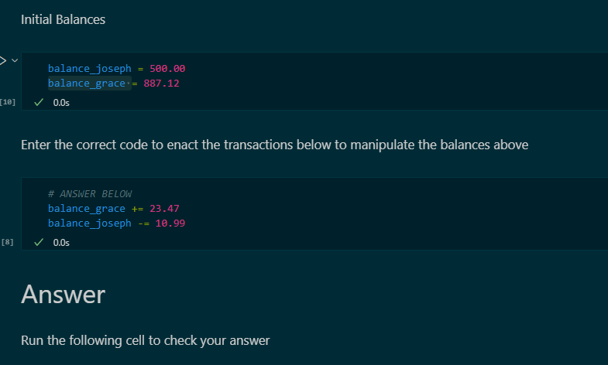
Remember to reset values
If you get an answer wrong, remember to reset the variables before you run your code again.
Otherwise, you might have the correct answer, but your variables are wrong

Slide 20
What do I do when stuck
Google
Stack Overflow
The Slack (join link in email)
Each other
Us
The Q&A sessions

Slide 21
Questions
Enjoy the course!!

